Slide 1



FUEL EXPENCE TRACKER
A SMART APPLICATION TO LOG, MONITOR, AND ANALYZE VEHICLE FUEL EXPENSES

Slide 2



Project Overview
The Vehicle Fuel Expense Tracker is a Vue.js-based web app to log and monitor fuel expenses and mileage.
It helps users analyze fuel consumption patterns and manage vehicle running costs efficiently.

Slide 3


TECH STACK USED
1
HTML
4
Node Js
2
CSS
5
Express Js
3
Vue Js
6
Bootstrap

Slide 4

PLANNING
Define Features
Database Schema Design
Backend Setup
Frontend Setup
Create pages:-
RegisterPage
LoginPage
HomePage
AddVehiclePage
FuelLogPage
ViewLogPage

Slide 5




ROLE & RESPONSIBILITY
Badal Singh Rathore
Creates Mongoose schemas and API endpoints for fuel logs and vehicle data. Handles data validation, error handling, and session-based access control.
Bhavya Patel
Responsible for implementing user authentication, including the login and registration functionality with secure session handling.
Fenil Shiroya
Work on fetching and displaying vehicle-wise fuel stats, including mileage and total fuel expenses including pagination and filter logs by Date. He will ensure accurate data retrieval and assist in organizing the stats layout.

Slide 6



Mayank Goyal
Handles the fuel log form, mileage calculation, and API integration in AddFuelLog. Also manages UI styling, vehicle data display, and user navigation.
Rahul Saini
Will focus on the visual representation of fuel logs, using tables to enhance clarity. He will collaborate on making the stats more user-friendly and insightful.
Varnika Jain
Design and implement the dashboard and add vehicle feature, enabling users to view, add, and manage their vehicles.

Slide 7
EXECUTION
Backend Setup & Schema Design:
Page Creation & Data Integration:
Data Display & Binding:
Component Connectivity:
Consistent UI/UX Theme:

Slide 8



CHALLENGES
Efficient Data Management:
Component Communication
Responsive Design Implementation
Managing and updating the dynamic fuel log data efficiently was a key challenge. As the app grows, handling large datasets and ensuring fast, real-time updates required careful planning of data structures and methods
Ensuring smooth interaction between different Vue components without external state management libraries (like Vuex) was challenging. Passing data between components and ensuring synchronization between them required detailed handling of props, events, and computed properties.
Ensuring the application provided a consistent and user-friendly experience across various devices (desktop, tablet, mobile) while maintaining a single, cohesive theme was a challenge

Slide 9
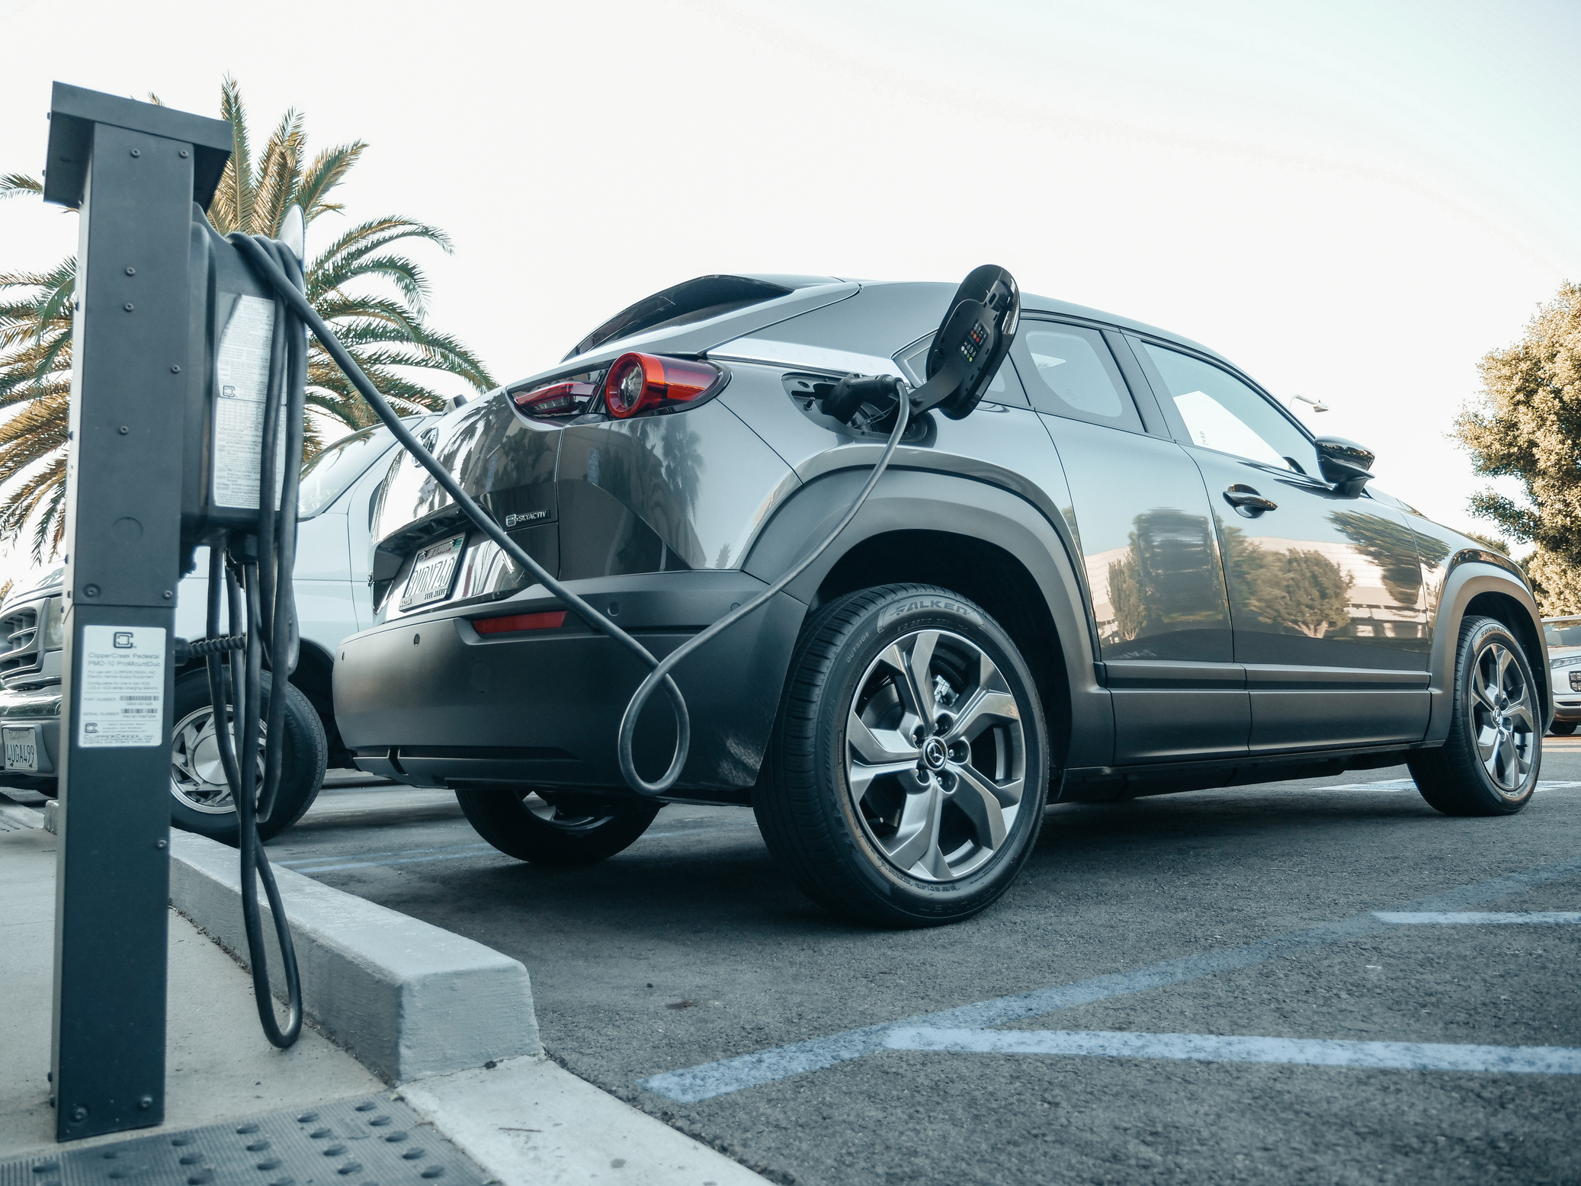
LEARNINGS
Vue.js Reactivity & Component Structure
Dynamic Data Binding:
Responsive Web Design
Component Communication in Vue:
UI/UX Design Principles:

Slide 10
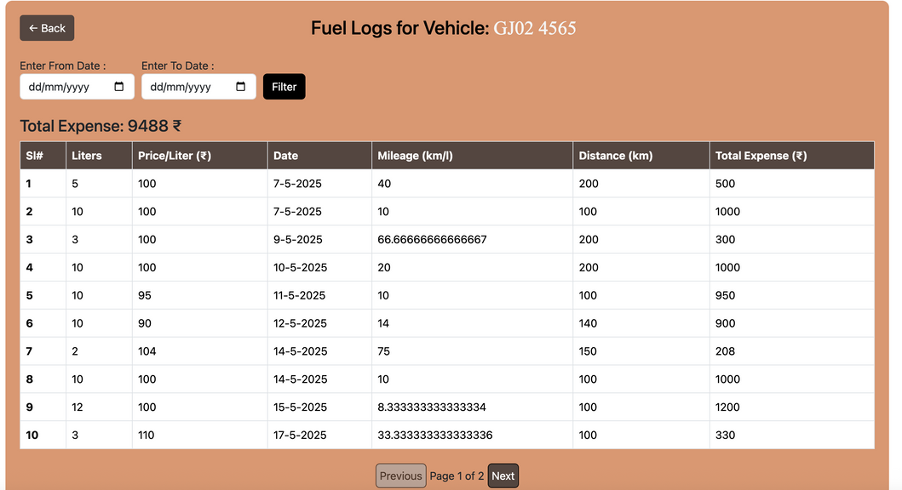
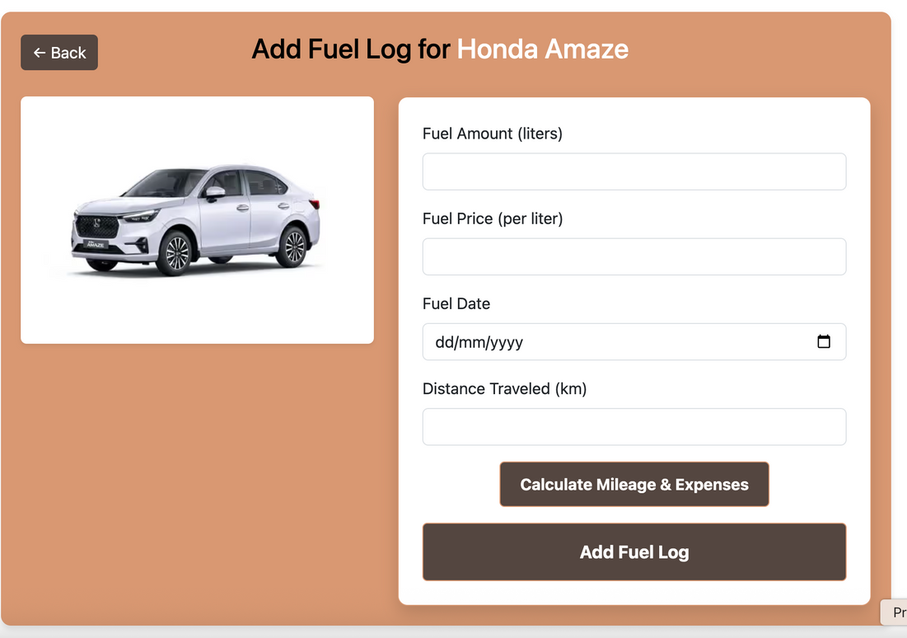
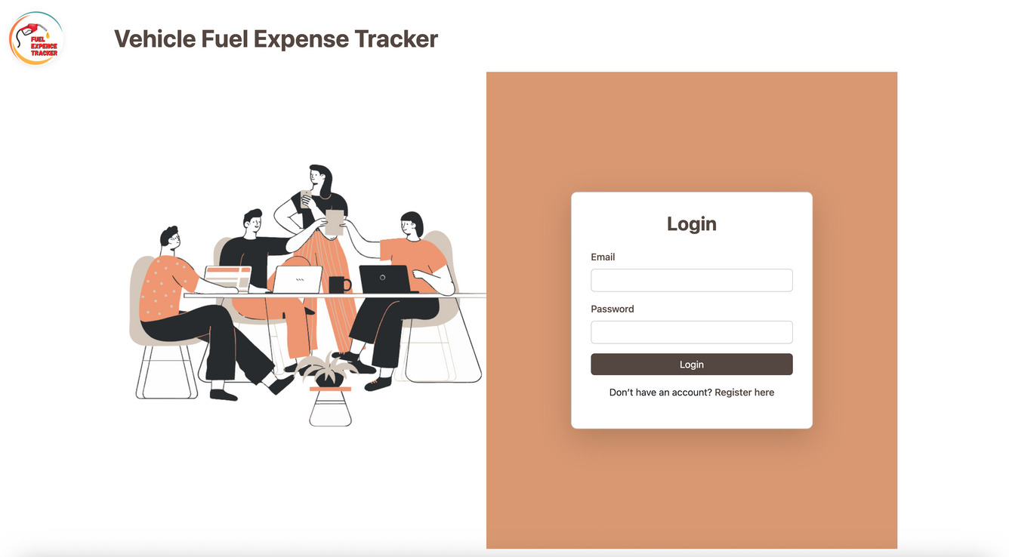
LOOK

Slide 11
THANK YOU
FOR YOUR ATTENTION
धन्यवाद!
આભાર!

